Slide 1
FAcebox
Slowing down Social media.

Slide 2
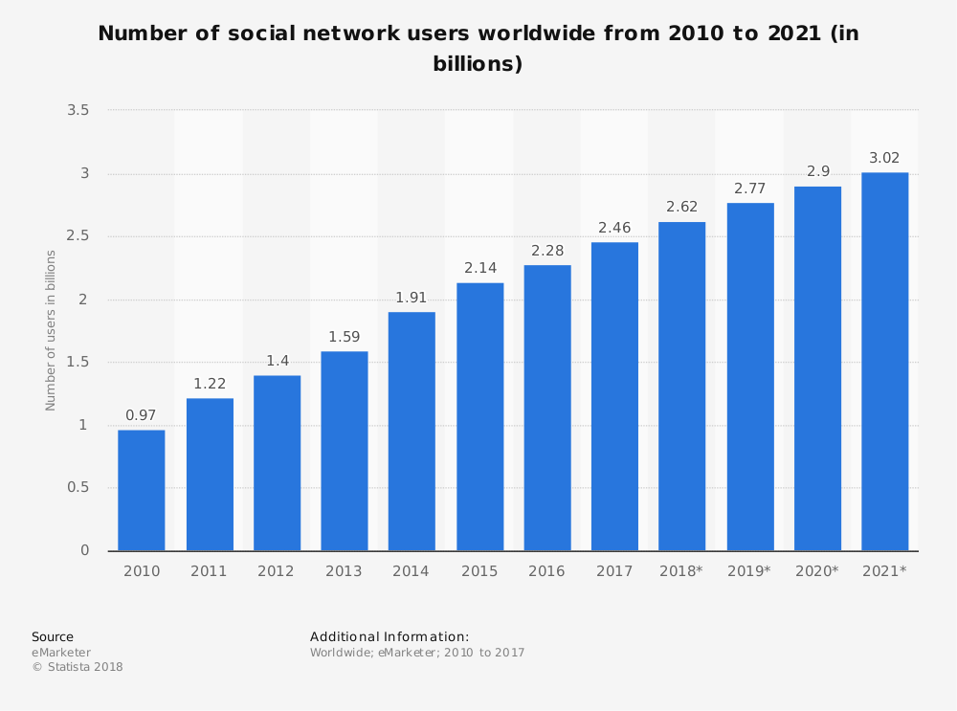
Context
Social network penetration worldwide is ever-increasing
Facebook user base is predicted to rise to 65% in 2020 (Statista, 2018)
(Statista, 2018)

Slide 3
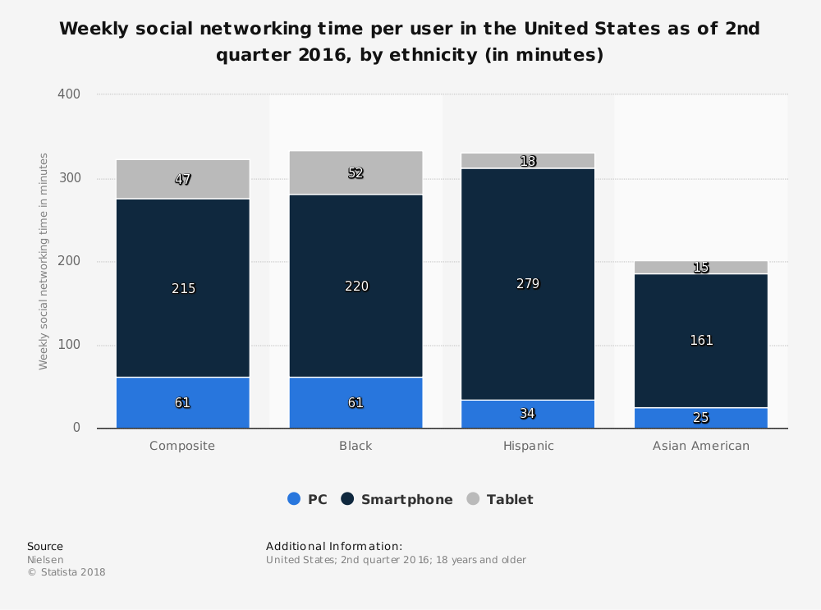
Context 2
Smartphones are the most popular format for social media access
Young adults, the people with high levels of social media use feel a greater sense social isolation (Primack et al. 2017)
(Statista, 2018)

Slide 4
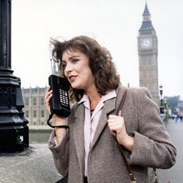
Background (techhology)
The world’s first mobile phone call was carried out in Aug 1973 by Martin Cooper, a senior engineer at Motorola, the mobile he used was a prototype that weighed 1.1Kg.
As mobile devices became more akin to the devices used today (Wi-Fi, 4G, touch screen interfaces), so the social media platforms migrated from desk top personal computers to mobile phones.
With the growth in mobile text and quick photo sharing came the diminishing breadth of macro level news stories in favour of smaller more localised news feeds based on personal experience or social sharing. One of the offsets of constant connectivity is always being available
BT Pearl Mobile 1986 (BT Pearl Mobile Phone 1986, 2018)

Slide 5
Background (FoMO)
FoMO is characterized by the desire to stay continually connected with what others are doing. (Przybylski et al. 2013)
Self Determination Theory - fulfils three basic psychological needs (Kirsh, 2012.p84)
Self Esteem
Positive Emotions
Vitality
Imagined communities are formed through other psychological needs too such as autonomy, competence, and relatedness (Ryan and Deci, 2000)
BT Pearl Mobile 1986 (BT Pearl Mobile Phone 1986, 2018)

